Slide 1
Clustering NBA Players Based On Their Shot Profiles
Kyrus Wankadiya
Final Presentation
3/13/25
COMP 4448

Slide 2
Problem Description
Clustering players based on the location of their shots could help a team find players who may:
Fill a role a team believes they need
Solve a weakness in their offense
Replace an injured player
Project to improve in the future
Goal of the project
Find players that score in similar ways, using a distributions of all shots they attempt over the course of a season, including coordinates and description of each shot

Slide 3
The Dataset
The NBA has used various types of tracking technology over the last 20 years to track the location of shots taken. Using data from 2013-14 season onwards, as this is when the NBA started to utilize Second Spectrum tracking technology
ShotQuality.com did not respond to request
wanted to use their API with more advanced data such as defender distance, probability of shots, etc.
Contains a lot more data related to the motion of the player and others on the court
2011 to present seasons
Would be closer to the data that an NBA team would use

Slide 4
The Dataset:
4.32M row csv, with every NBA shot taken between 2004 to 2024
https://github.com/DomSamangy/NBA_Shots_04_24
Key data and a few potential issues:
Coordinates of shot
Action Type (such as driving layup, running hook shot, jump shot)
70 categorical values in dataset which I aggregated and combined into 5 types:
Rim, Drive, Break, Moving, Jumper
Data appears relatively clean, though positions are missing for 20 total players, easy to fill in with some research
Some noise in this data (i.e. 25-foot dunk, shots attributed “at the rim” that were 15+ feet away)

Slide 5
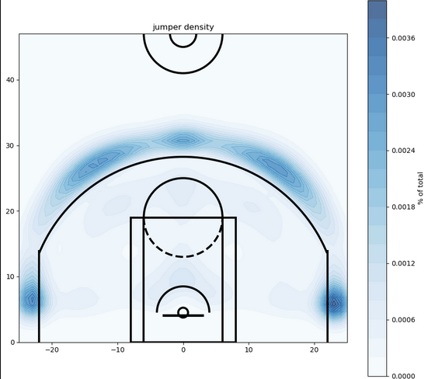
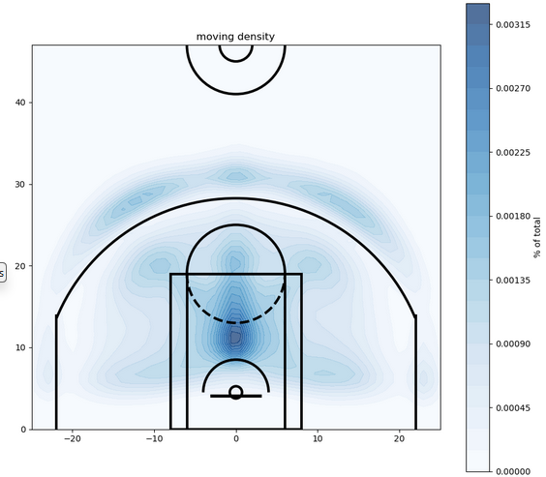
Basketball Explanations (Shot Categories Pt 1)
JUMPER
A shot taken from anywhere away from the basket, usually from a standing position, implying someone else passed them the ball. Generally easier shot that modern offenses try to get often, and promotes floor spacing
MOVING
A tougher shot while moving, usually defended tightly. Important to be good at these when looking for someone who handles and creates offense against a set defense. Some overlap with “Drive”

Slide 6
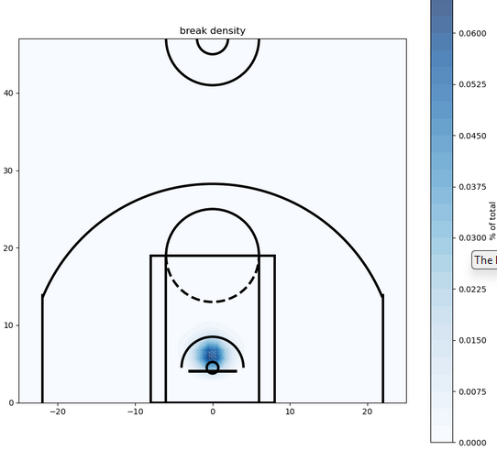
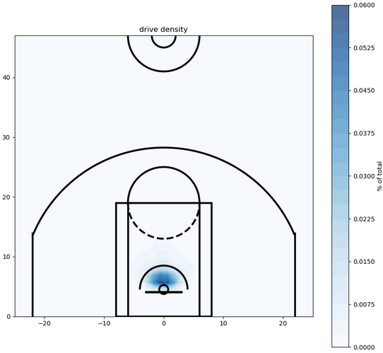
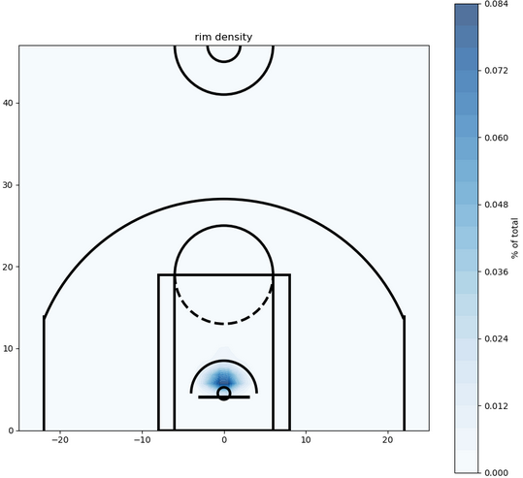
Basketball Explanations (Shot Categories Pt 2)
BREAK
A shot on the fast break (following a defensive rebound or a turnover). The goal is usually a shot at the rim. Defined in dataset as “running”
DRIVE
A shot which typically starts outside or in the mid-range, but the player dribbles to the rim for their shot. Another sign of valuable shot creation ability.
RIM
A shot very close to the basket, often a dunk or layup. Usually, they are passed the ball for an easy shot, or following an offensive rebound

Slide 7
Data Pre-Processing for Cluster Analysis
Filtered data to include:
All shot attempts taken between 2013-14 and 2022-23 NBA regular season, evaluate model on 2023-24 NBA regular season data
All Player-Seasons in which a player attempted at least 500 shots in that season
All shots with distance <=35 feet (removing outliers)
Categorized 70 shot descriptions into the 5 Action categories
Mass calculations:
NBA league average percentage of a shot at every coordinate on the court, using 1x1 bins
Kernel Density Estimate determine Strong/Weak spots where shots are taken/made

Slide 8
Gaussian Mixture Model (GMM)
With all the shot data overlapping, needed a clustering model that would
Adapt to abnormal density, gradients, and distributions
Not simply cluster all shots from the left vs all shots from the right like KMM or KNN
The data by nature is full of “outliers” and it’s rare that a player’s shot profile perfectly fits a cluster
“Probabilistic Assignment” of clusters works best for this kind of data

Slide 9
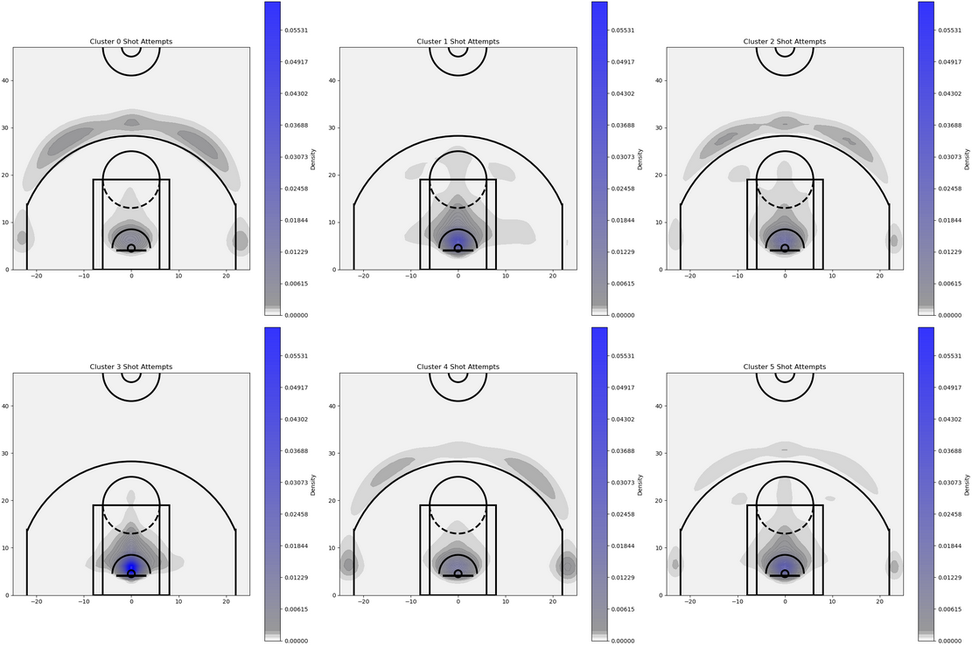
GMM Results (Overview)
6 clusters generated by GMM model
Distribution of shot attempts

Slide 10
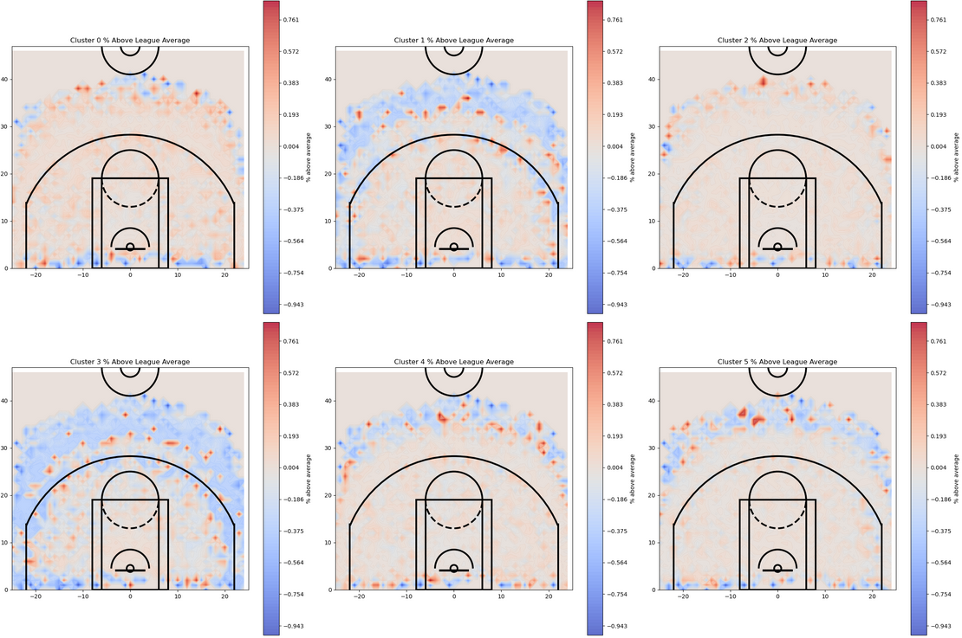
GMM Results (Overview)
6 clusters generated by GMM model
Shooting percentage compared to “expected” value calculated
Note: blue is below avg red is above avg

Slide 11
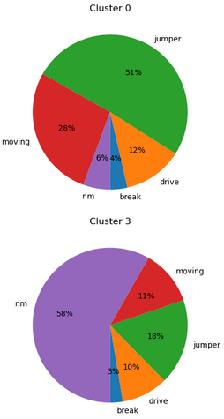
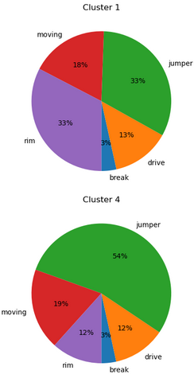
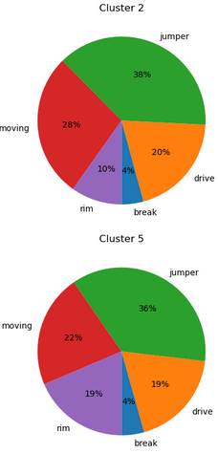
GMM Results (Overview)
6 clusters generated by GMM model
Distribution of shot actions

Slide 12
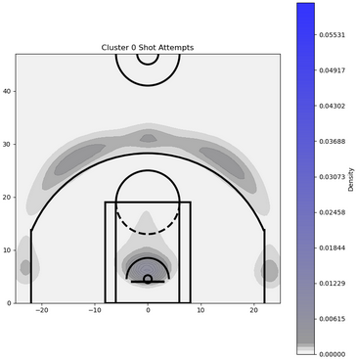
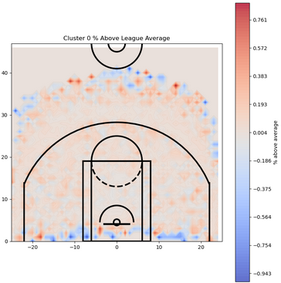
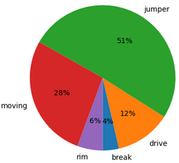
Cluster 0: Perimeter Shooters & Creators
Defining characteristics:
High volume of jumpers and moving shots
Positive efficiency shooting from 3 and mid-range
Mostly smaller players that are not near the rim a lot
Prominent Players:
Chris Paul
JJ Redick
Stephen Curry
Kyle Korver

Slide 13
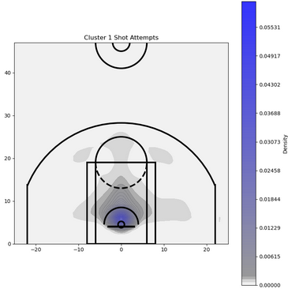
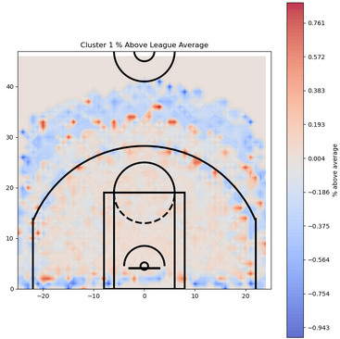
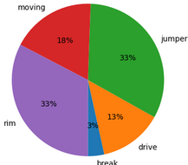
Cluster 1: Inside Scorers
Defining characteristics:
Shooting is generally closer to the basket, shows some ability to create
Some mid-range jump shooting
Don’t shoot a lot of 3s, or if they do, it is at a low percentage
Prominent Players:
2016-19 Giannis Antetokounmpo
Domantas Sabonis
2020-23 Jimmy Butler

Slide 14
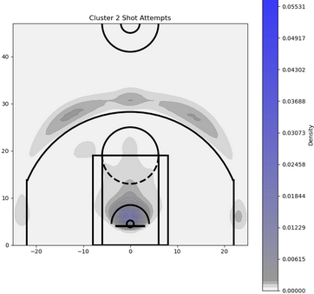
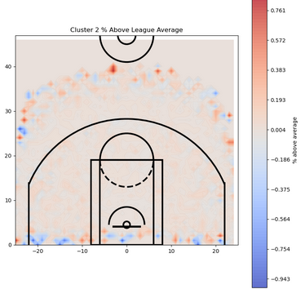
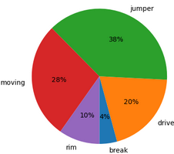
Cluster 2: Dual-Threat Shooters & Drivers
Defining characteristics:
Perimeter oriented players who can drive to the basket
Good shooters, particularly above average from mid-range
Moving + Drive indicates good versatility shot creation talent
Lots of star players in this one
Prominent Players:
Luka Doncic
Lauri Markkanen
Jayson Tatum
Jamal Murray

Slide 15
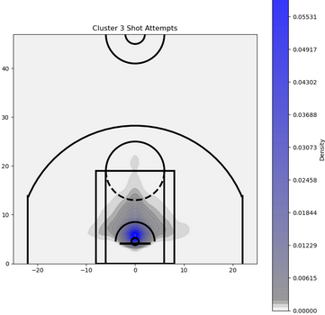
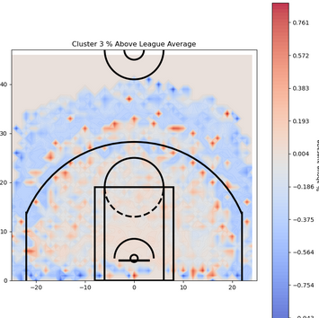
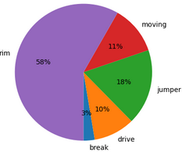
Cluster 3: Finishers In The Paint
Defining characteristics:
Pretty much only scoring near the basket, lots of layups and dunks
Mostly big men who score easily other players’ passes or rebounds
Little to no outside shooting or shot creation
Smaller cluster, since a lot of these players do not get many shot attempts
Prominent Players:
Rudy Gobert
DeAndre Jordan
Clint Capela

Slide 16
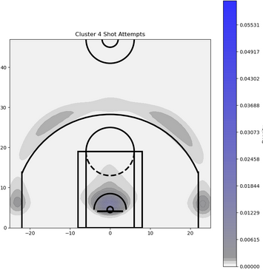
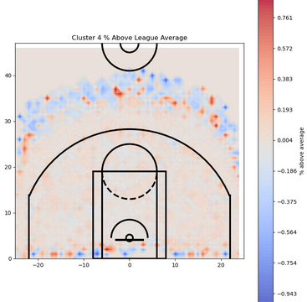
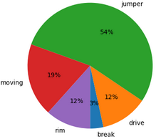
Cluster 4: Shooting Specialists
Defining characteristics:
Players who take a lot of jumpers and not much else
A mix of shot creators, and shooters who just take stationary shots
Very easy to fit in as a supporting player
Spend significant time in the corner, helping with offensive spacing
Prominent Players:
Lou Williams
2020-23 Norman Powell
Cavaliers Kevin Love
Danny Green

Slide 17
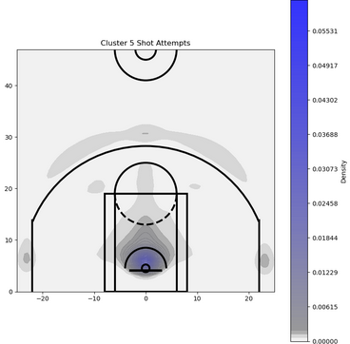
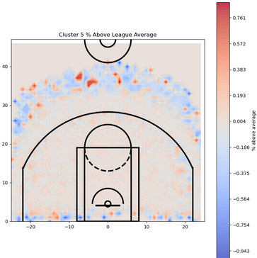
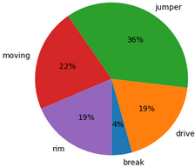
Cluster 5: Well-Rounded Efficient Scorers
Defining characteristics:
Balanced volume from all areas and shot types
High efficiency from 3 and mid-range
Average to above average shot creation
Like cluster 2, a good cluster for a star player to be in
Prominent Players:
Shai Gilgeous-Alexander
Paul Millsap
2015-19 Jimmy Butler
Nikola Jokic

Slide 18
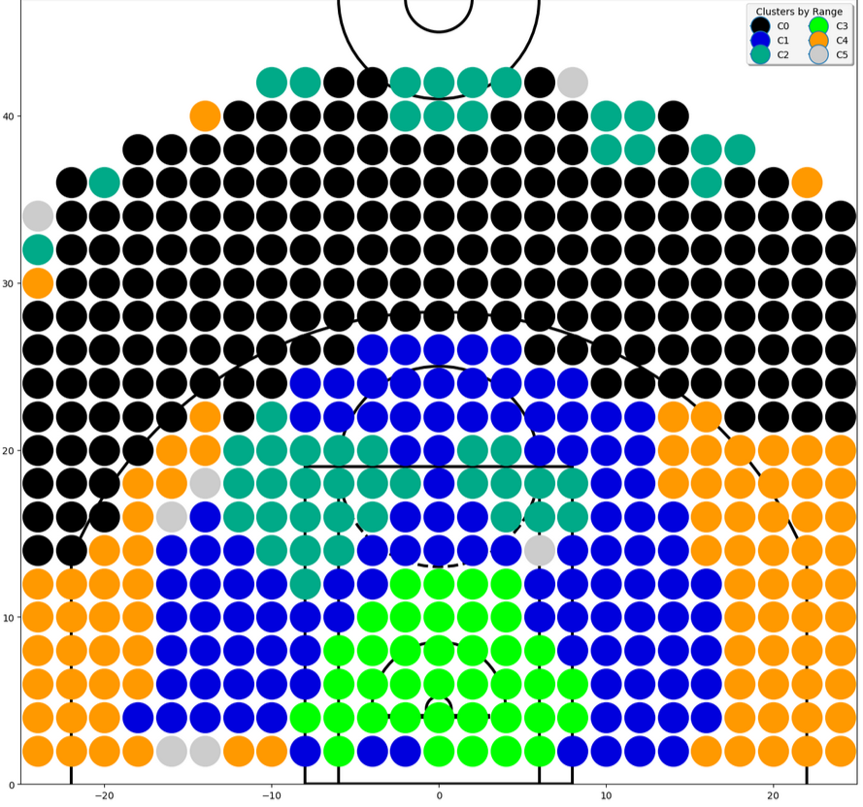
Where Does Each Cluster Like To Shoot From?
Black: Cluster 0: Perimeter Shooters & Creators
Blue: Cluster 1: Inside Scorers
Teal: Cluster 2: Dual-Threat Shooters & Drivers
Lime: Cluster 3: Finishers In The Paint
Orange: Cluster 4: Shooting Specialists
Gray: Cluster 5: Well-Rounded Efficient Scorers
Created by using dynamically generating bins, and most common cluster (relative to size of cluster) for shot attempts in each range

Slide 19
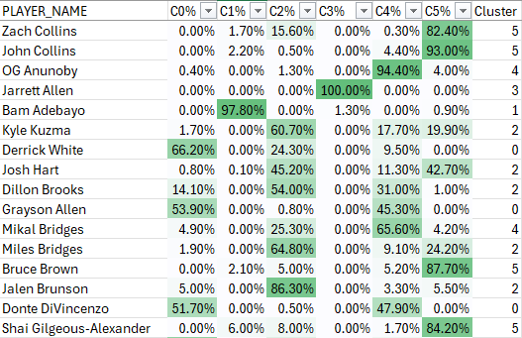
Validation
Validated using 2023-24 mock data
Manually categorized 173 qualifying players 0-5
Allowed to put in more than 1 cluster if it seemed close between 2 clusters
Utilized assignment probabilities (seen below)
Assigned 1 if GMM model is correct
If wrong:
assigned the % probability of “correct” cluster(s)
Resulting score of 0.8461
The model accurately clustered players 84.6% (compared to my manual categorization)

Slide 20
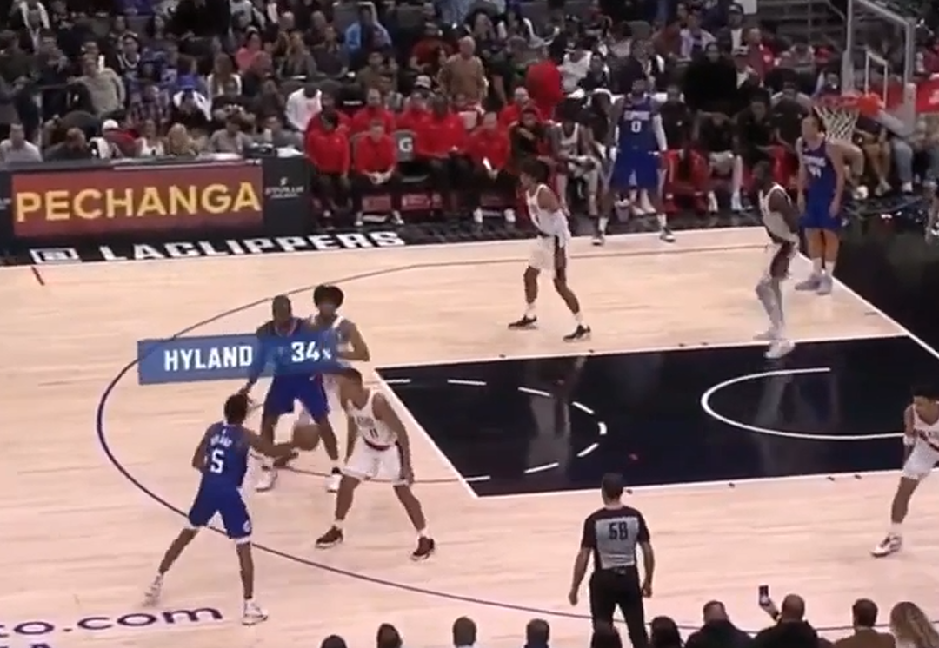
Ways To Improve
An NBA team would have much more detailed data to work with
More advanced motion data
Proximity to defenders
Account for in-game situations
Clustering players based on how closely they are defended
More targeted approach to assigning clusters
More accurate validation methods

Slide 21
Thank you!

